Slide 1
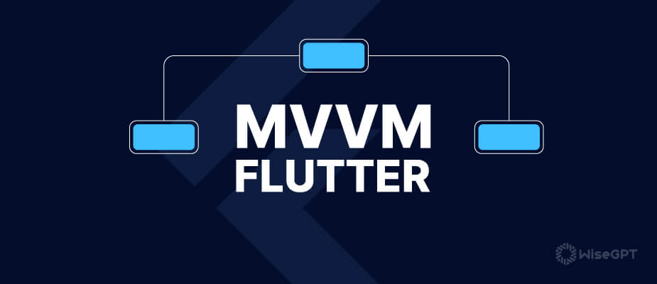
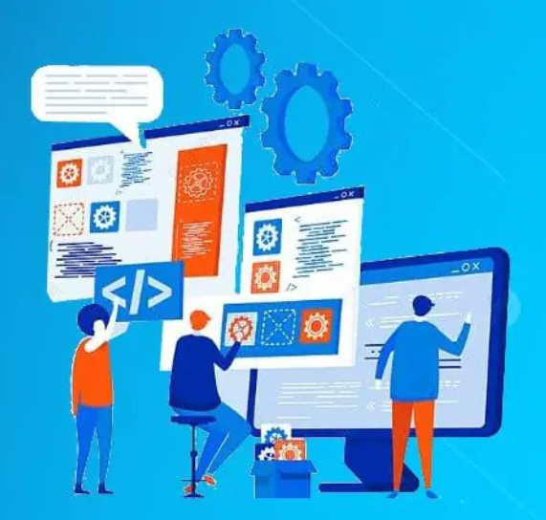
Is Application
Gehad Mohamed G1
Dina Bakry G2
Alaa Nabil G1
Yasmeen Amar G3
Fatma Ahmed G3
Rana Foad G2

Slide 2
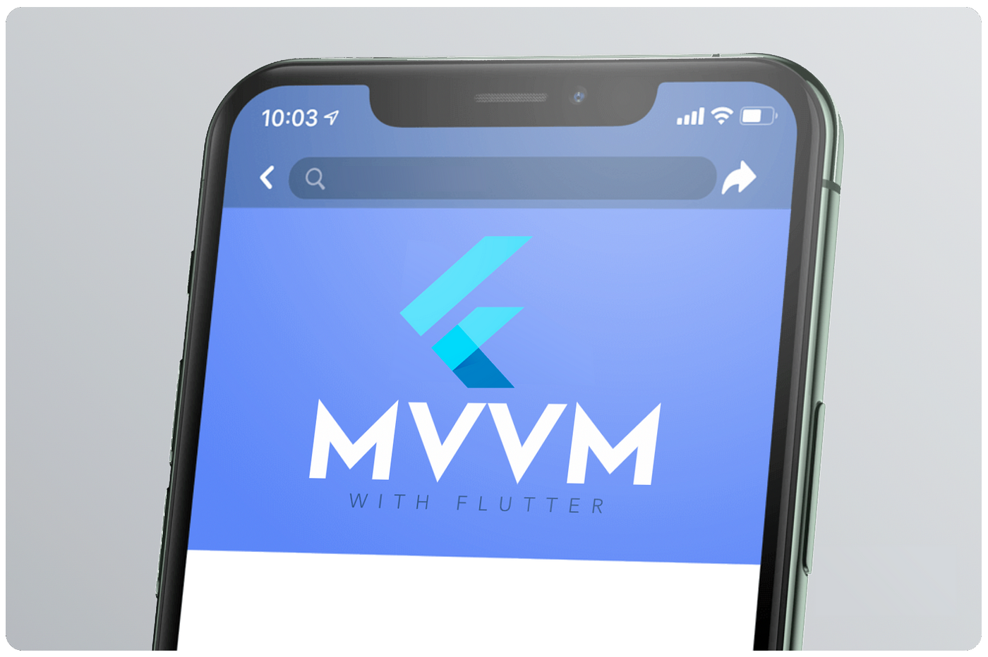
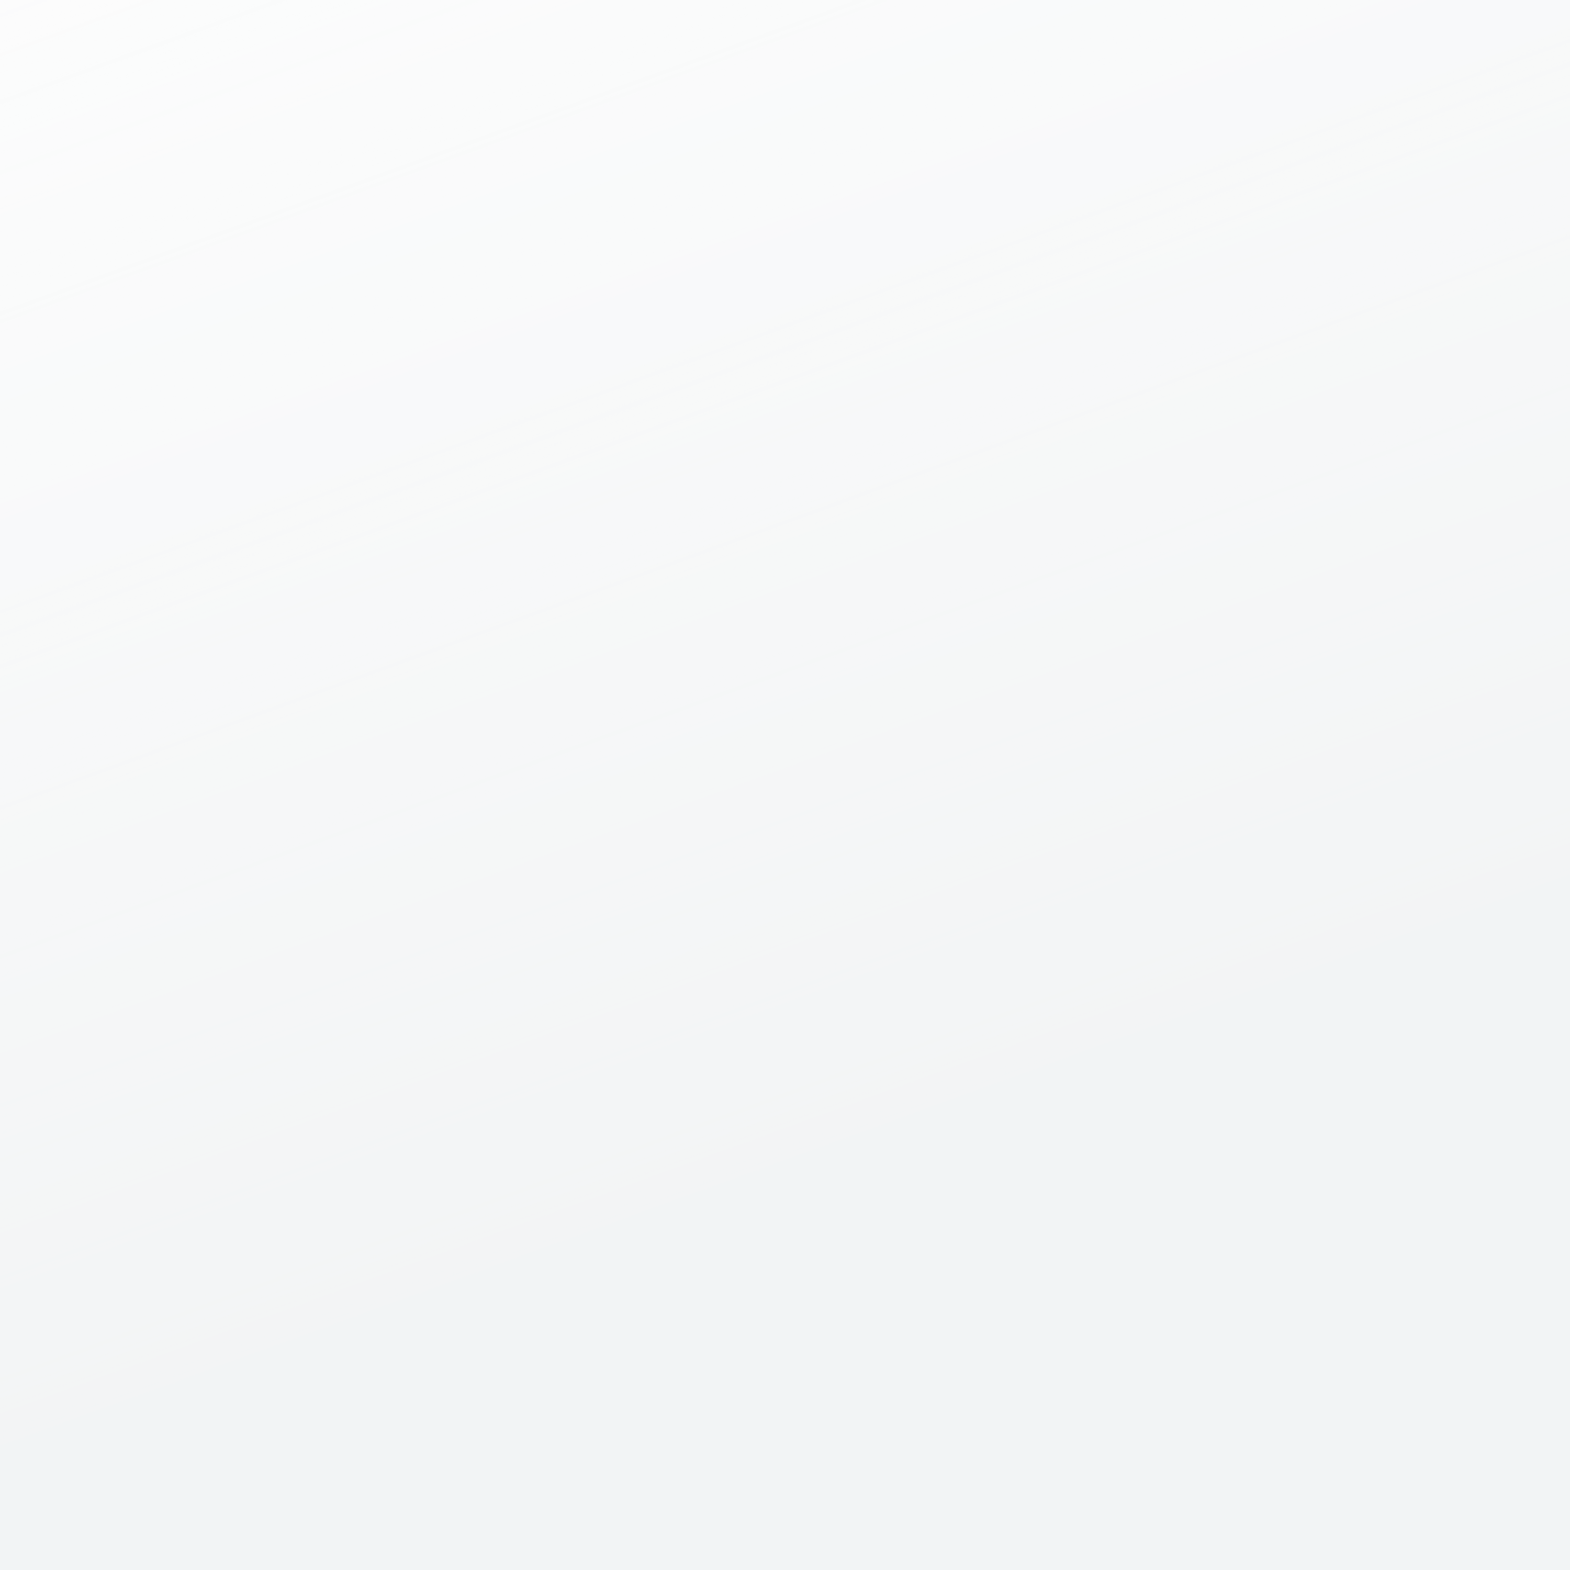
CONTENT
01
03
02
MVVM diagram
04
Inrto
what MVVM
Application
06
08
05
07
Handle null
data
View
model
View
model

Slide 3
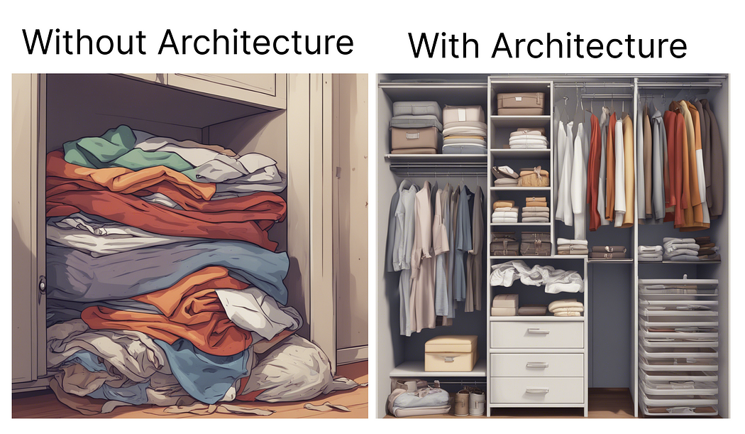


Introduction
When starting on a new development project, a familiar question often arises: What’s the best architectural pattern or state management approach to ensure our codebase remains organized, adaptable, and conducive to effective testing? This continuing challenge underscores the importance of structuring our codebase for clean maintainability, seamless updates, and the clear separation of UI and business logic.

Slide 4
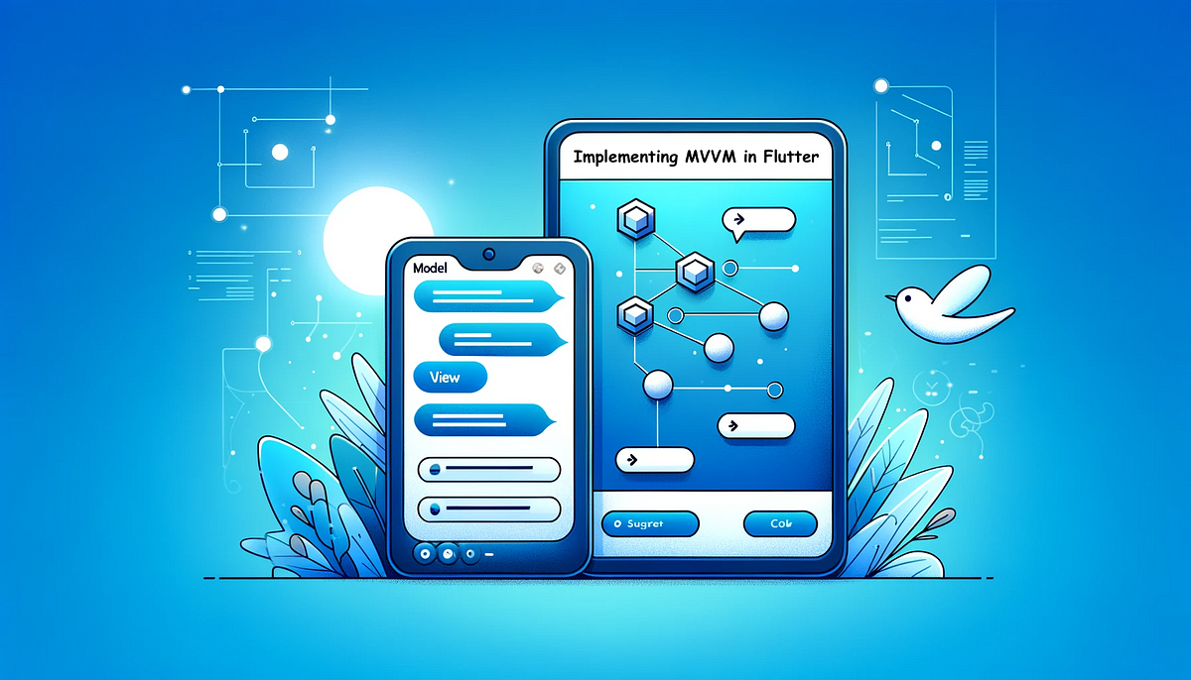
WHAT IS MVVM
Model–View–View Model (MVVM)
MVVM (Model-View-ViewModel ) is an architectural pattern used in software development, including in Flutter, to separate the concerns of an application into three distinct components: Model, View, and ViewModel.
This separation of concerns helps in creating a well-organized and maintainable codebase.

Slide 5
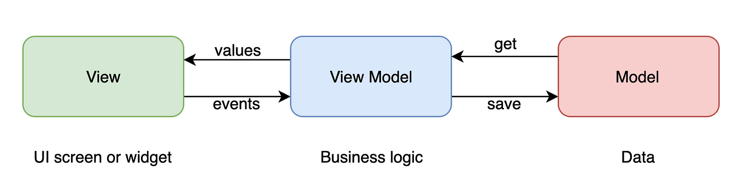
Model: The Model represents the data and business logic of the application. It encapsulates the data structures, database interactions, and any other core application logic. In Flutter, the Model might include classes or data models that define the data schema, as well as services for fetching or manipulating data.
View: The View represents the user interface (UI) of the application. In Flutter, this includes widgets and screens that render the user interface and display data to the user. The View should be as dumb as possible, meaning it must not contain business logic but should rather focus on UI presentation.
ViewModel: The View Model acts as a bridge between the Model and the View. It prepares and transforms the data from the Model to make it suitable for presentation in the View.

Slide 6
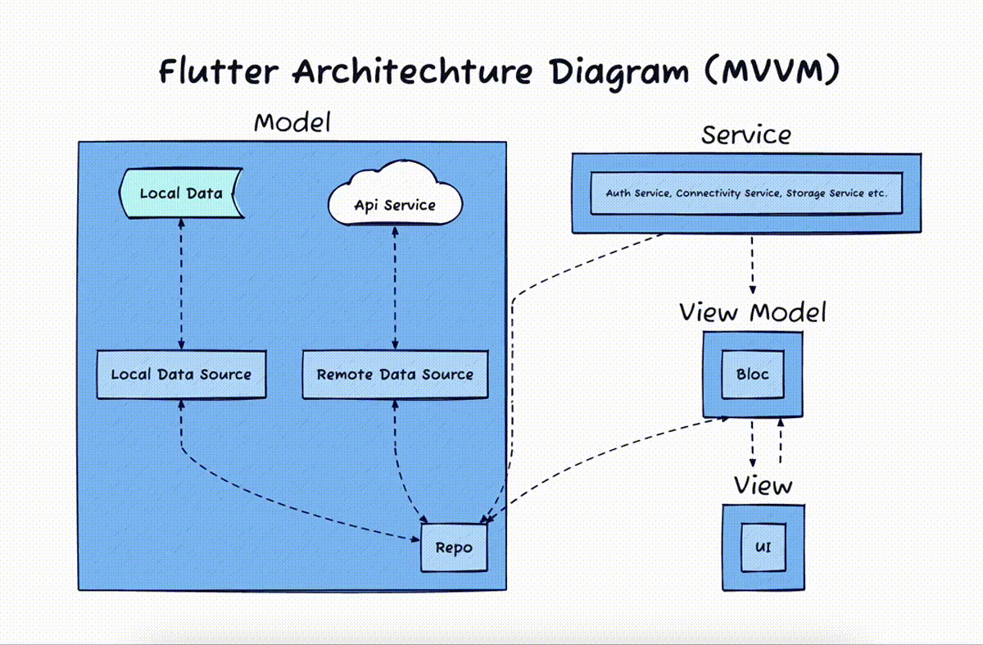
MVVM Diagram
Remote Data Source: This is a component that provides access to remote data, such as an API. Make sure to not access the Remote database directly to the View-Model or View layer.
Service: This is a component that provides a wrapper to third-party services, such as connectivity, storage, or API service
Repositories (Repo): This is a component that abstracts away the details of how data is retrieved and stored.
View Model: This is a state management library that can be used to implement MVVM in Flutter.
View: View is the user interface that the user will see and interact with. Make sure the view needs to be dumb as dumb as possible. So It must not access any Repo or Service directly.

Slide 7
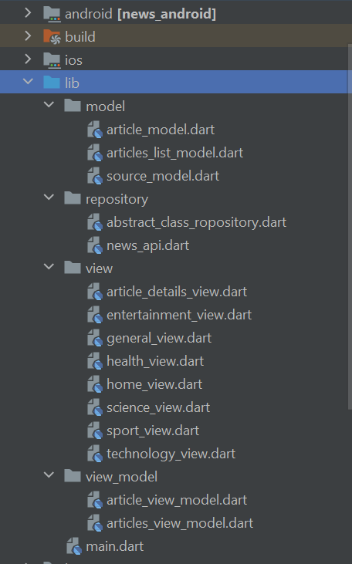
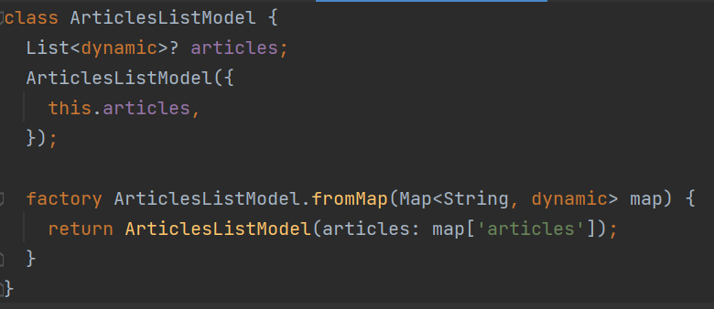
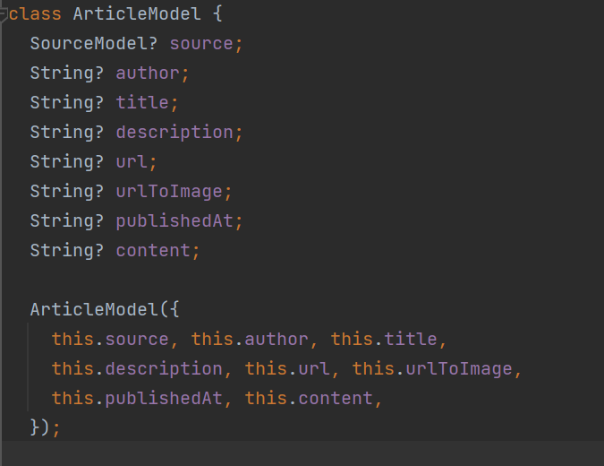
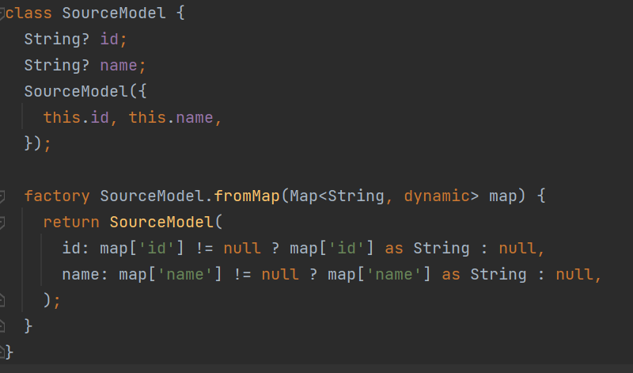
Application
Model
The Model in the MVVM architecture is the heart of the application. It's responsible for handling all the business logic and managing the data.

Slide 8
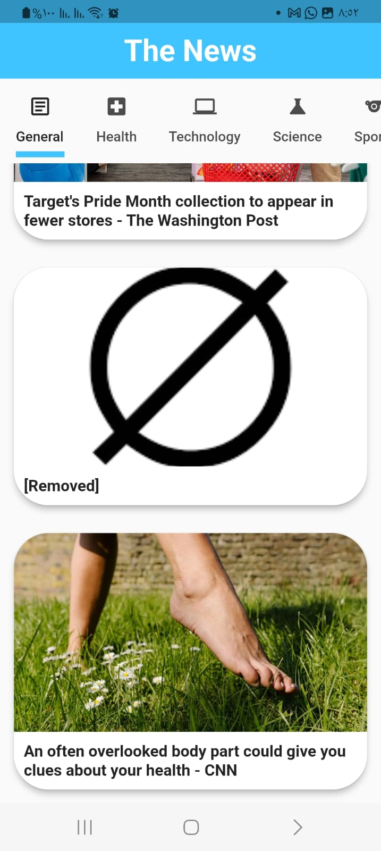
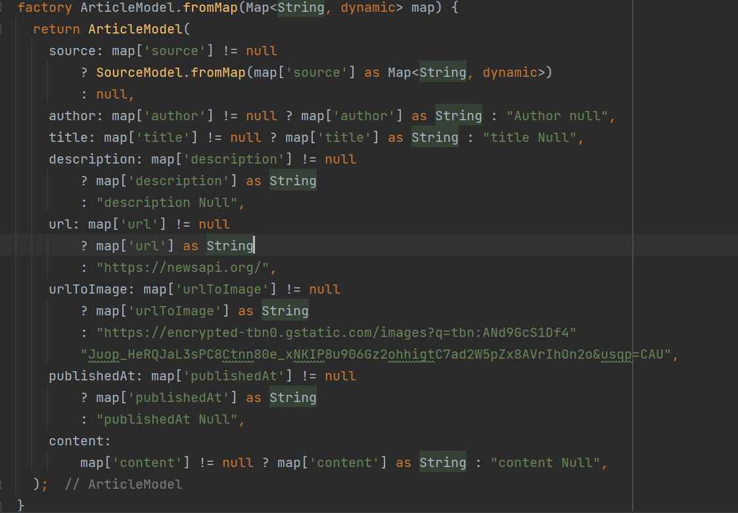
Handle Null Data

Slide 9
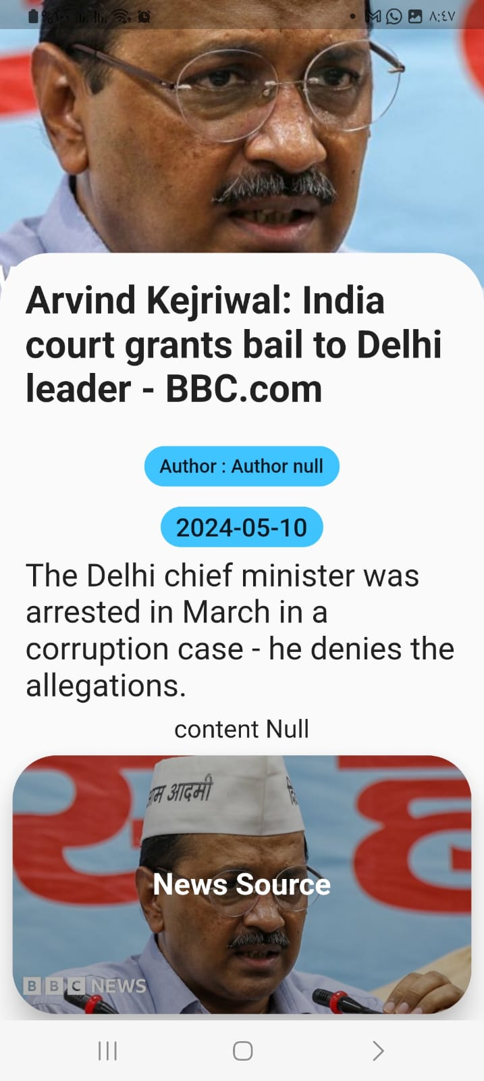
Handle Null Data

Slide 10
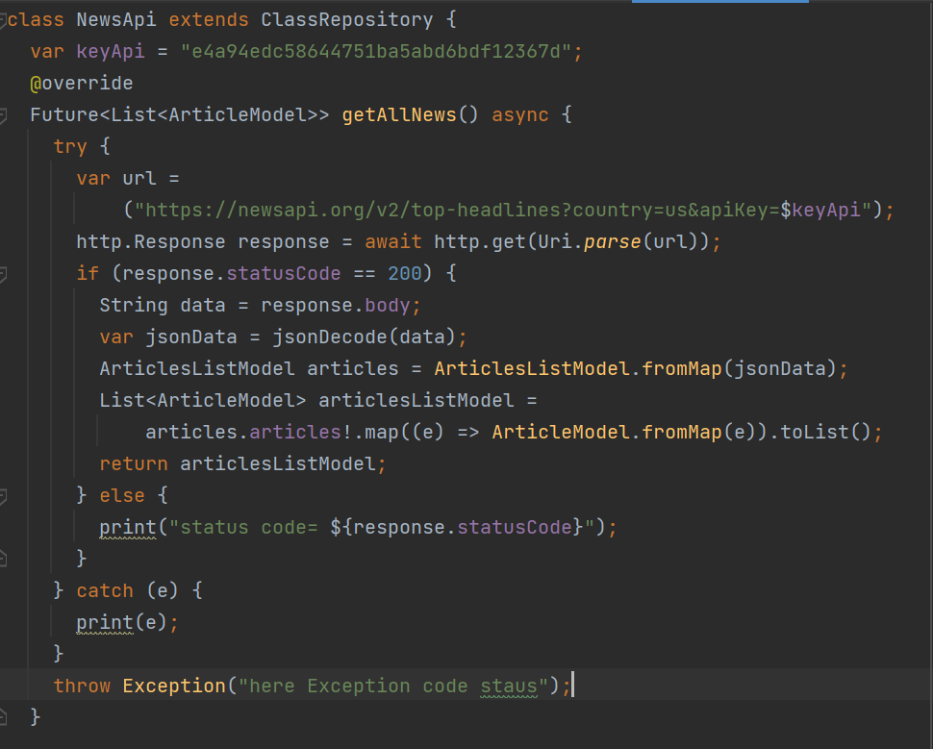
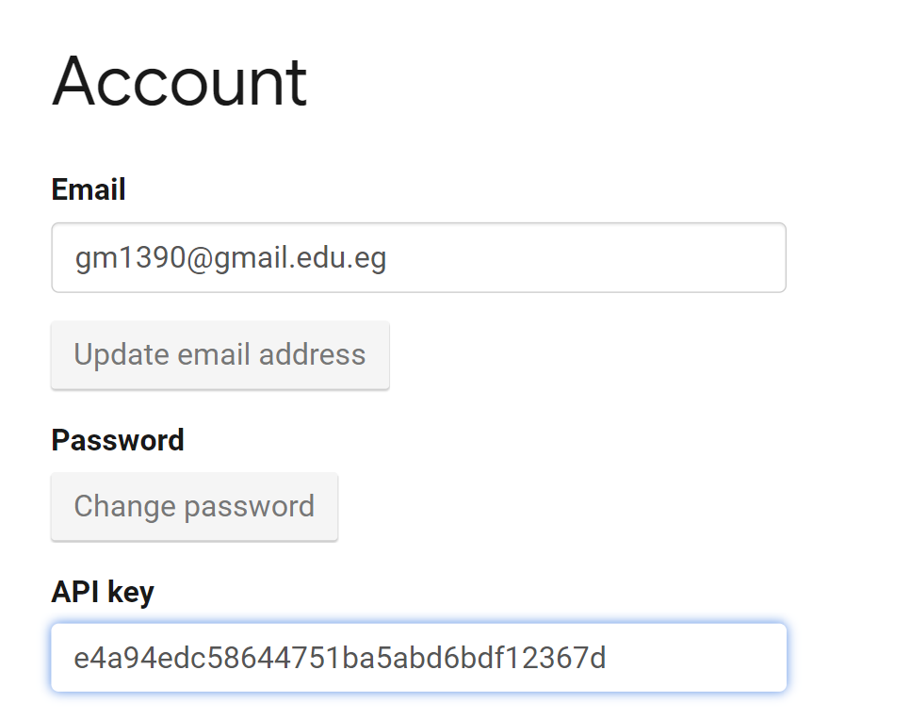
Repository

Slide 11
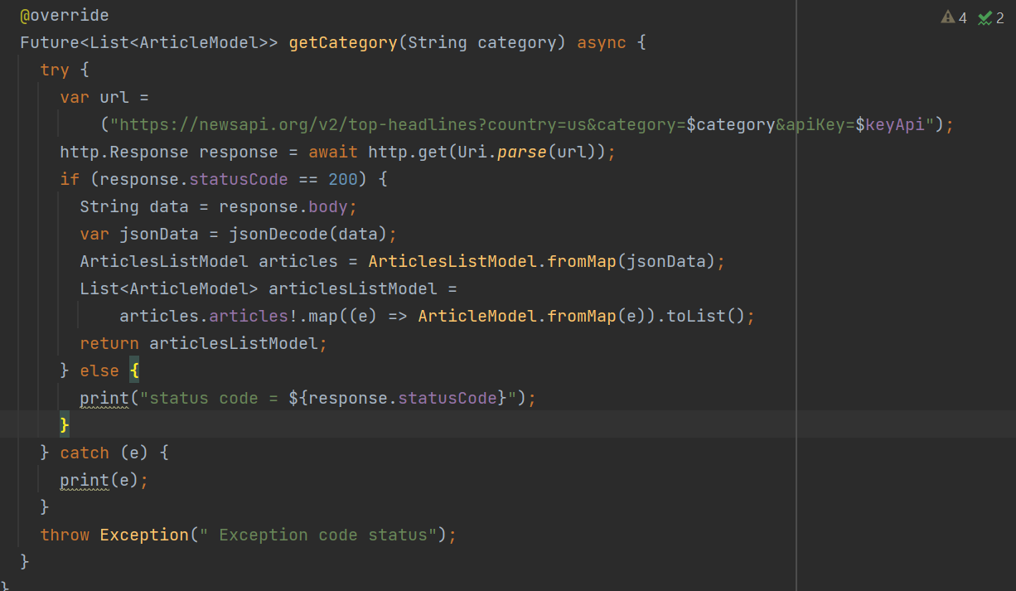
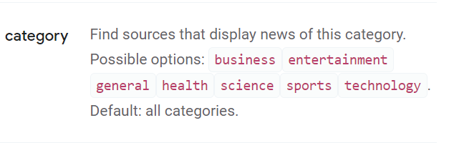
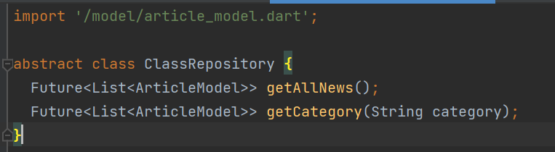
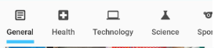
Repository

Slide 12
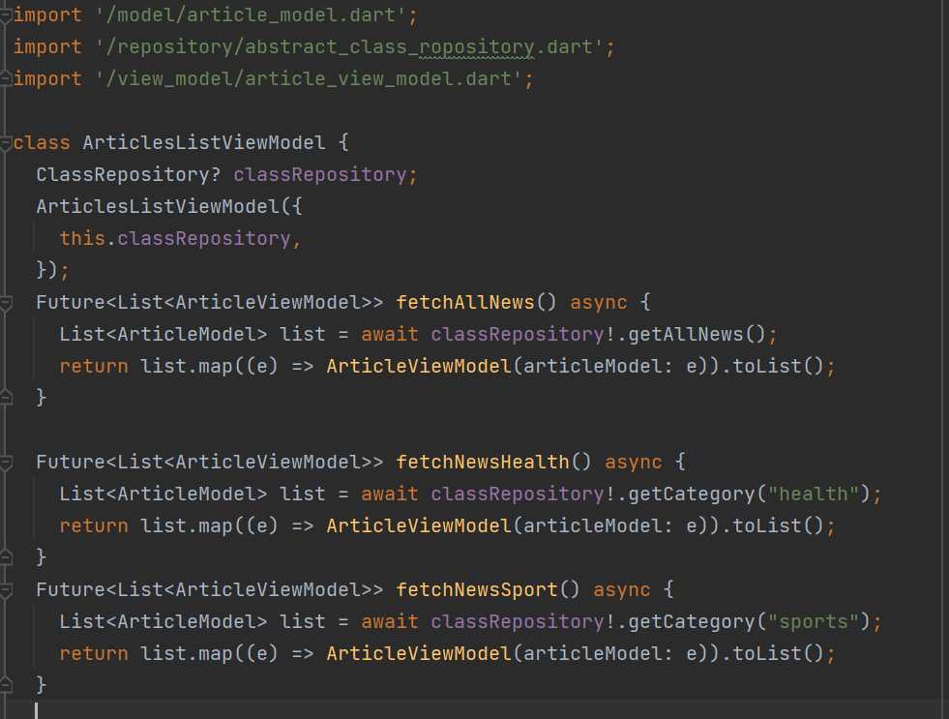
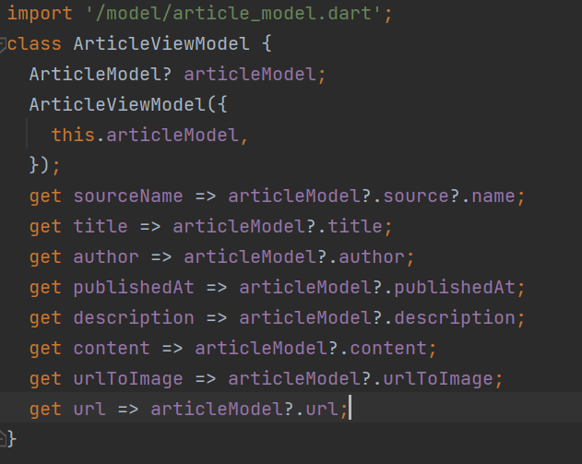
ViewModel
The ViewModel is the bridge between the Model and the View. It includes all the ViewModel-related classes that handle user event requests and update the View.

Slide 13
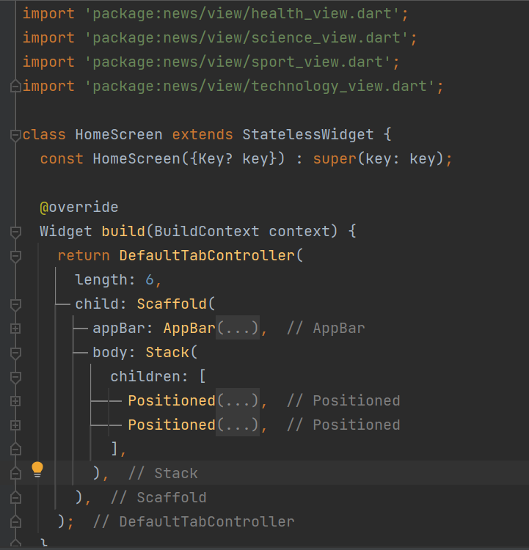
View
The View in the MVVM architecture is responsible for displaying the UI and capturing all the user events. It includes all the view-related classes, like the class Home Screen. The View interacts with the ViewModel to handle user events and update the UI.

Slide 14
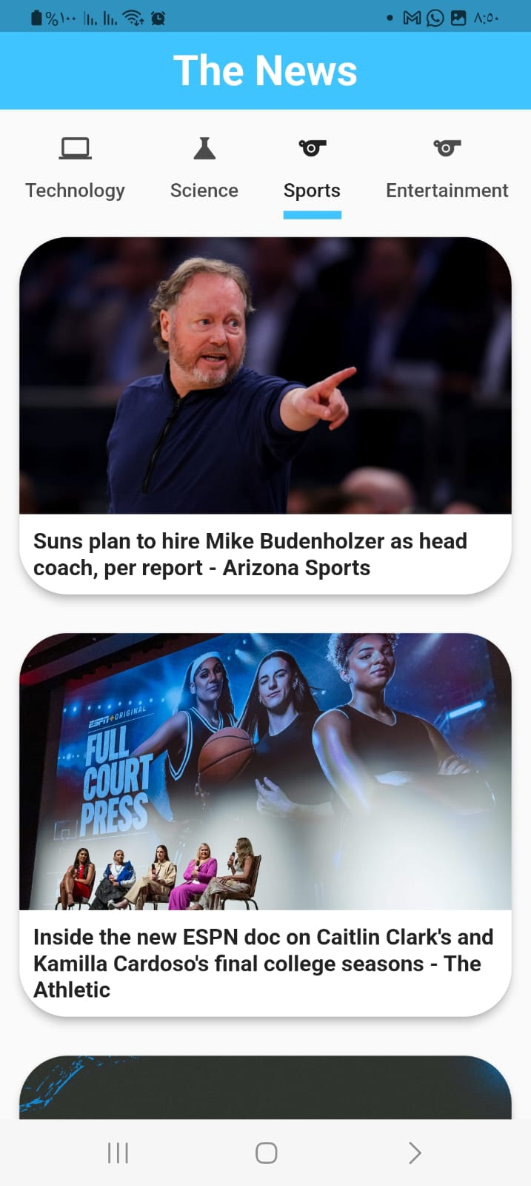
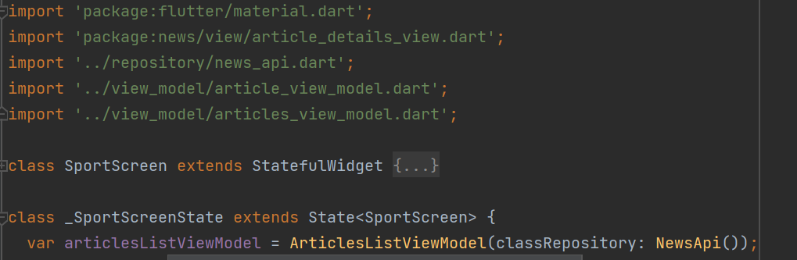
View

Slide 15
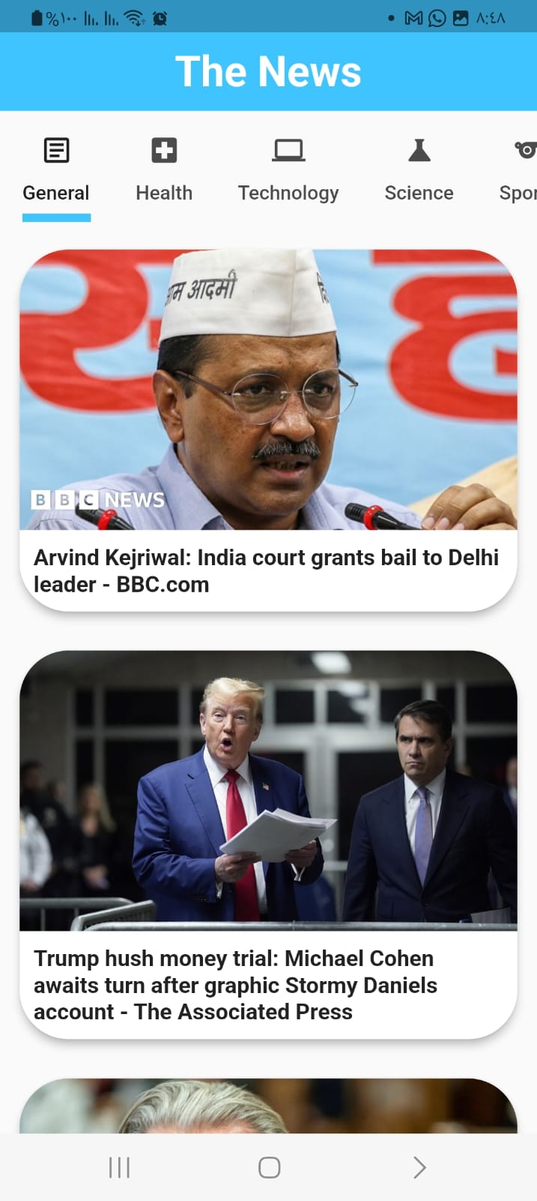
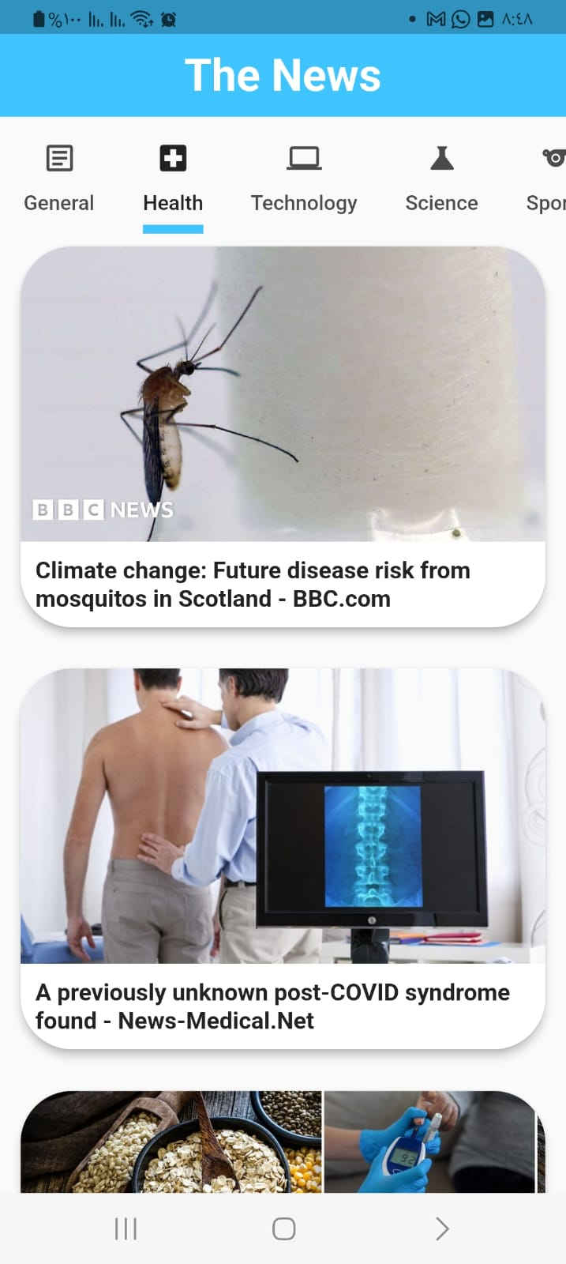
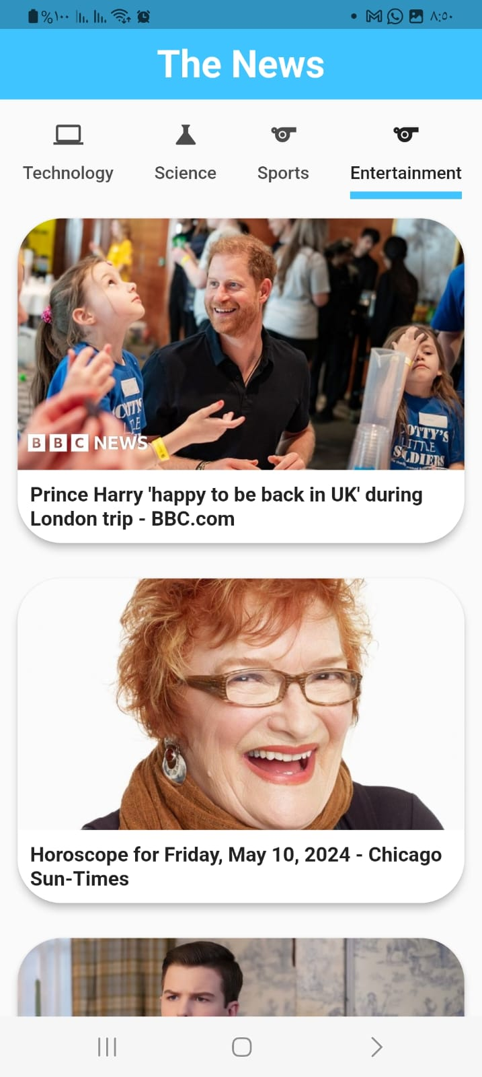

Slide 16

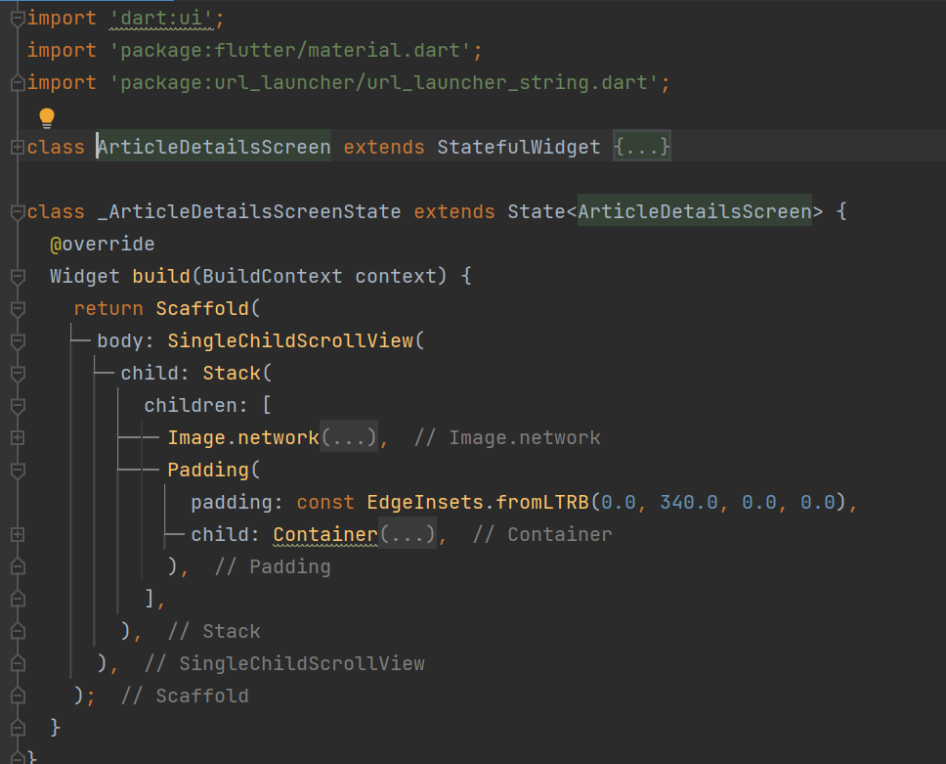
Article Details View

Slide 17
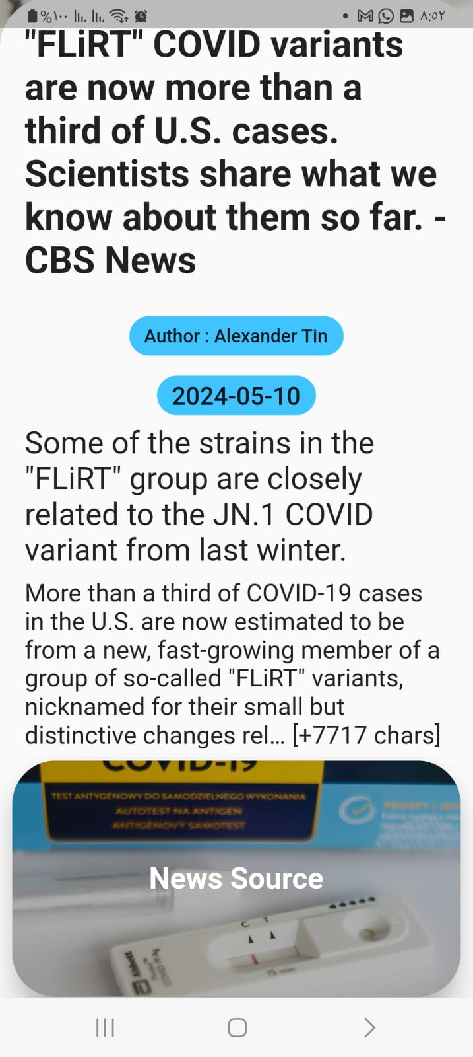
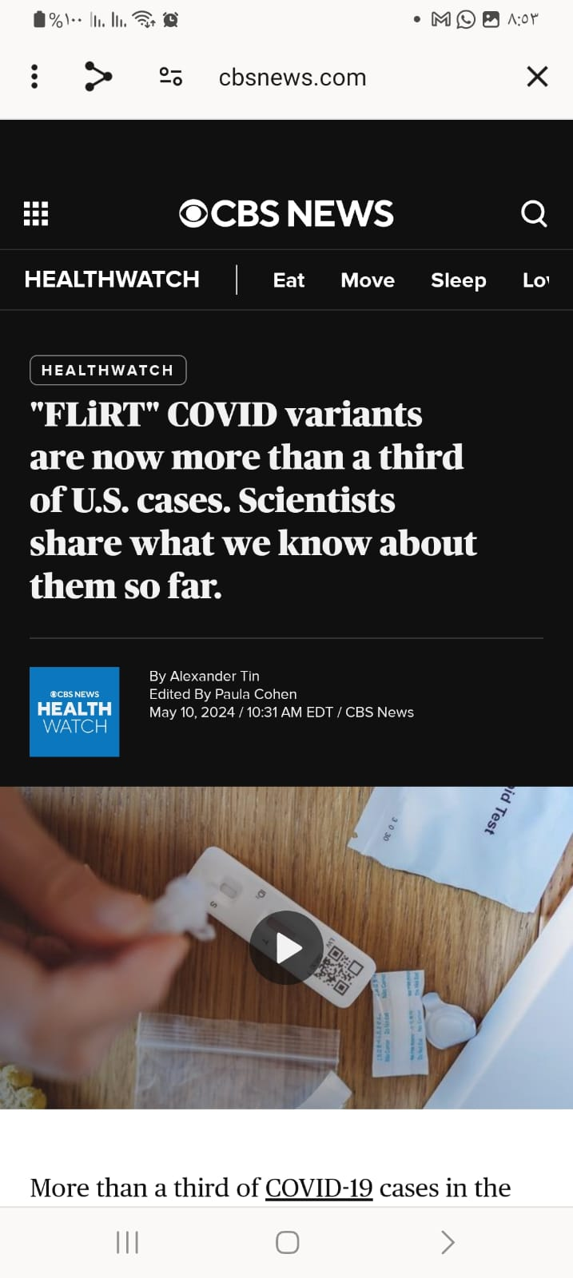
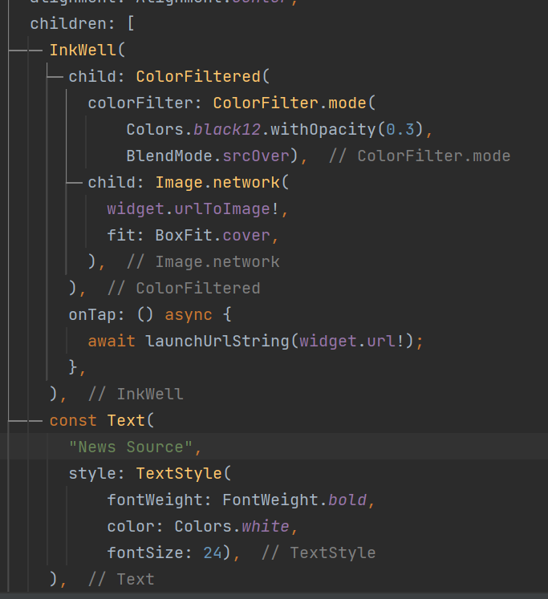
News Source

Slide 18
t
Thanks

